Slide 1
Virtual Positivity Week 2021
Monday 25th January – Friday 29th January

Slide 2
Every year in St. Francis Xavier JNS the ‘Blue Shield Flag Team’ in school organise a ‘Positivity Week’ for the boys and girls.
The children engage in lessons and fun activities focusing on ‘friendship’ and having a zero-tolerance approach to ‘bullying’ in our school.
Our slogan in school is
‘Smiles are our Superpower’.
Notes:
NOTE: To change images on this slide, select a picture and delete it. Then click the Insert Picture icon in the placeholder to insert your own image.

Slide 3
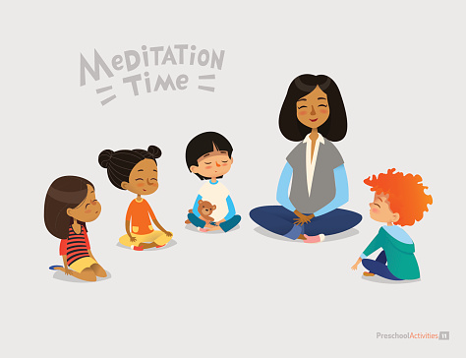
Mindful Monday
Share a smile at home ☺
Meditation – listen to the video above
Notes:
NOTE: To change images on this slide, select a picture and delete it. Then click the Insert Picture icon in the placeholder to insert your own image.

Slide 4
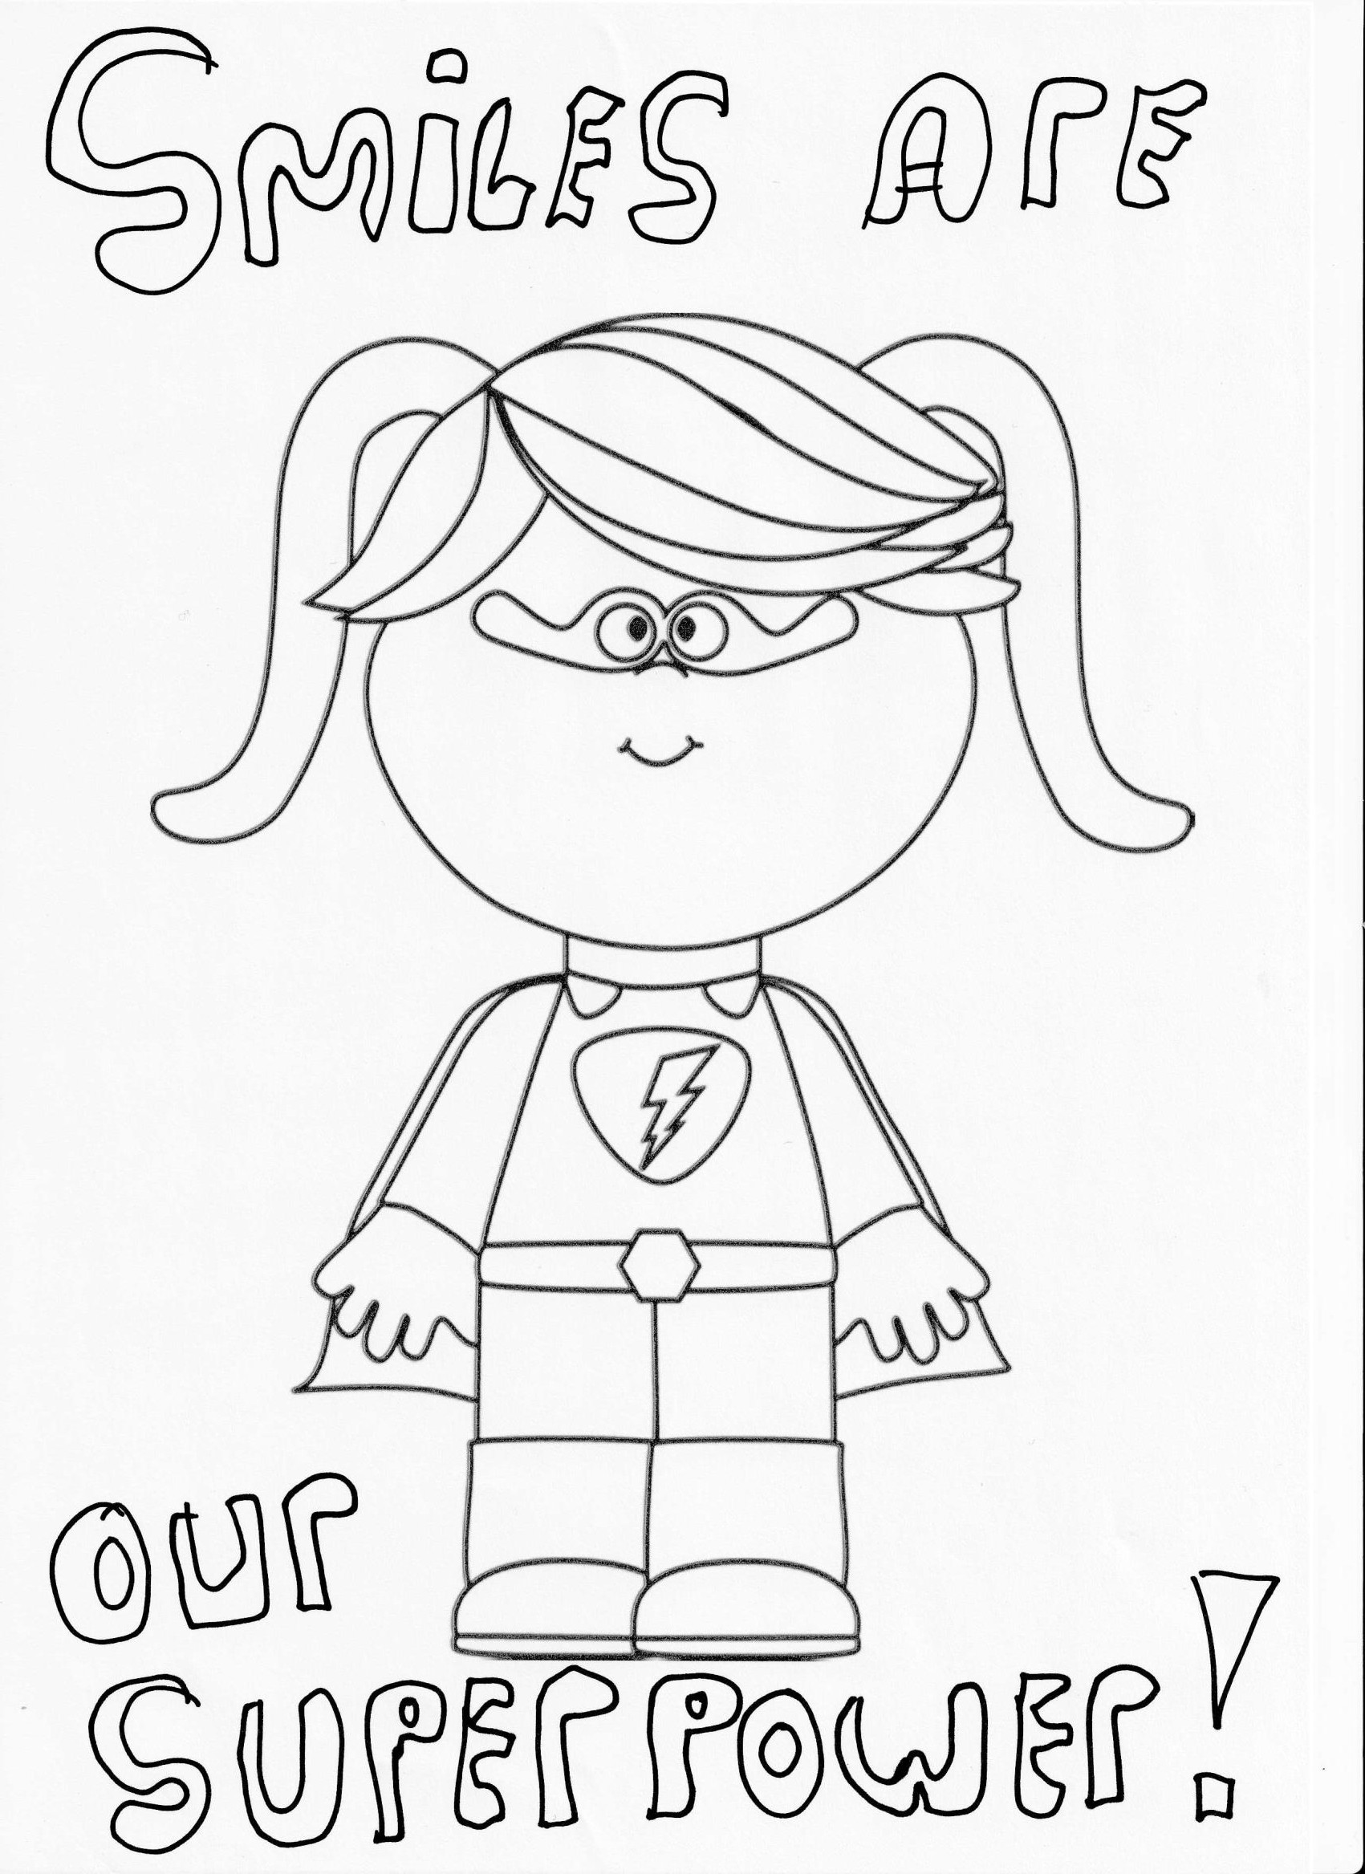
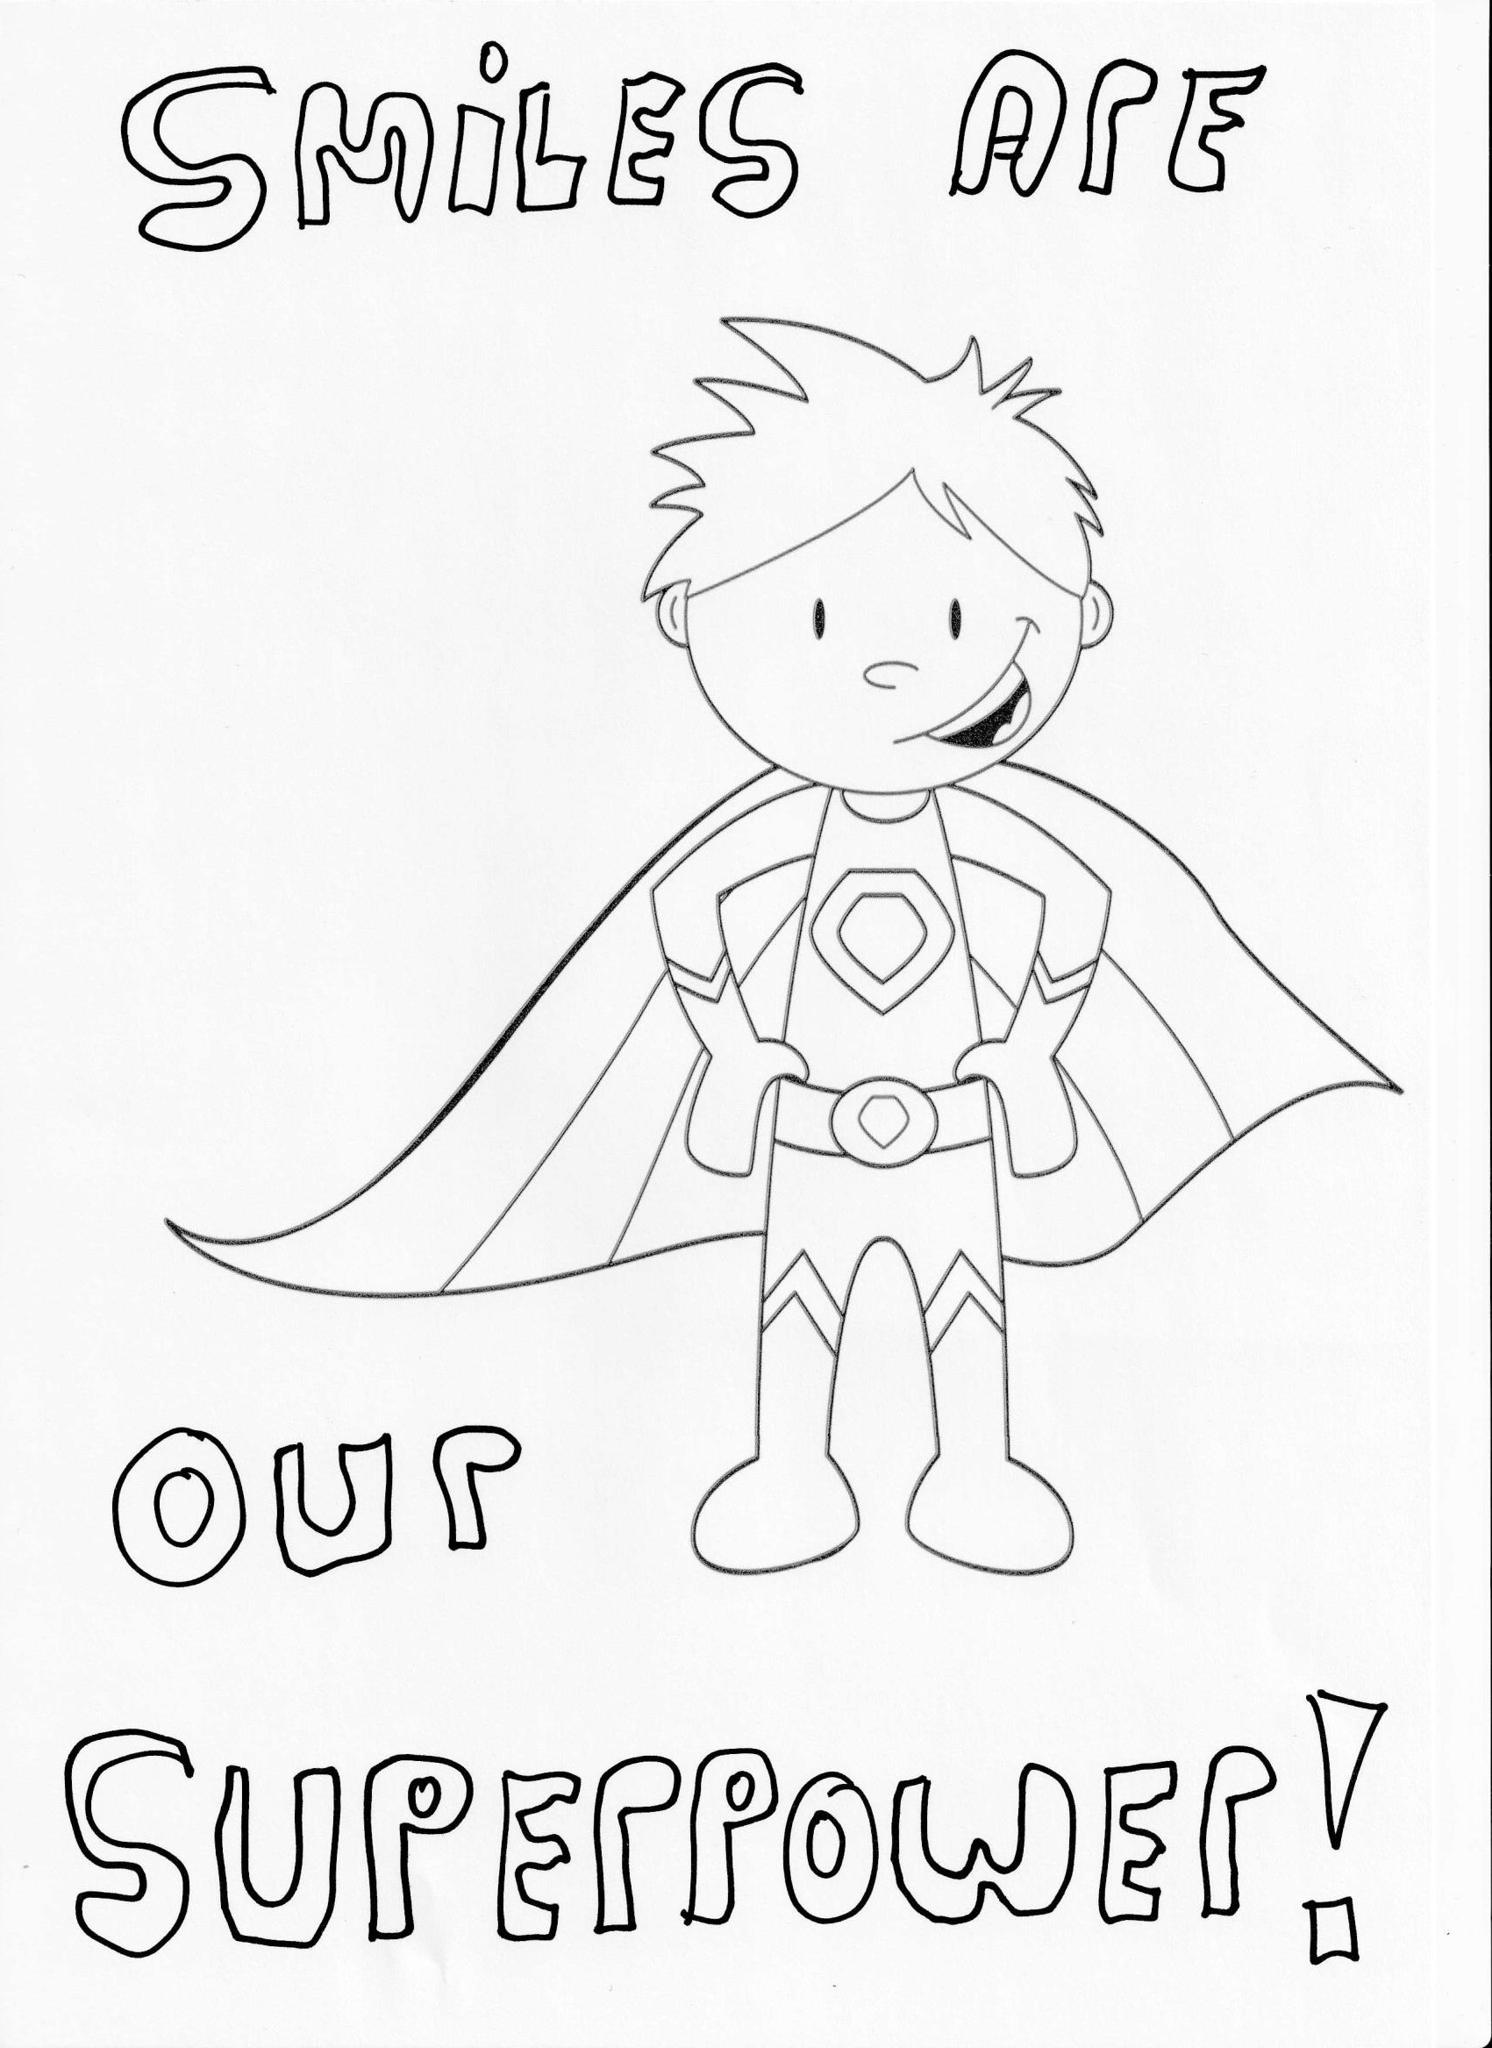
Terrific Tuesday
Design a poster. Slogan: ‘Smiles are our Superpower’
Use template provided or create your own!!! Share with your teacher on SeeSaw!!
Notes:
NOTE: To change images on this slide, select a picture and delete it. Then click the Insert Picture icon in the placeholder to insert your own image.

Slide 5
Wellness Wednesday
Random Act of Kindness day
Help mum/dad with a task at home today
Make a thank you card for someone
Give at least 3 compliments today!
Go for a nature walk in your 5km zone
Write a list of 5 people who inspire you
Notes:
NOTE: To change images on this slide, select a picture and delete it. Then click the Insert Picture icon in the placeholder to insert your own image.

Slide 6
Thankful Thursday
Listen to Anti-bullying/Friendship story and afterwards draw a picture of you with your friends!
Junior/Senior Infants
https://www.youtube.com/watch?app=desktop&v=Ej1LIIN34SM

Slide 7
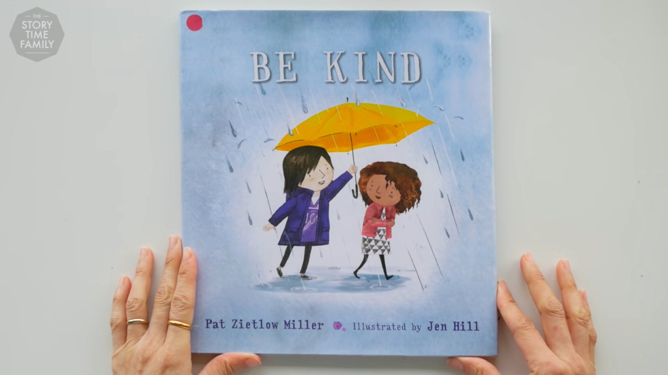
1st class/2nd class Listen to the story and afterwards make a list of 10 ways you can be kind to others
https://www.youtube.com/watch?v=kAo4-2UzgPo

Slide 8
Feel-Good Friday
Do some yoga today https://cosmickids.com/
Do your favourite Go Noodle dance https://www.gonoodle.com/
Reduce screen time by 1 hour (adults and children!)
Get outside and get 1 hour of exercise today

Slide 9
Have a great week! ☺

